Slide 1


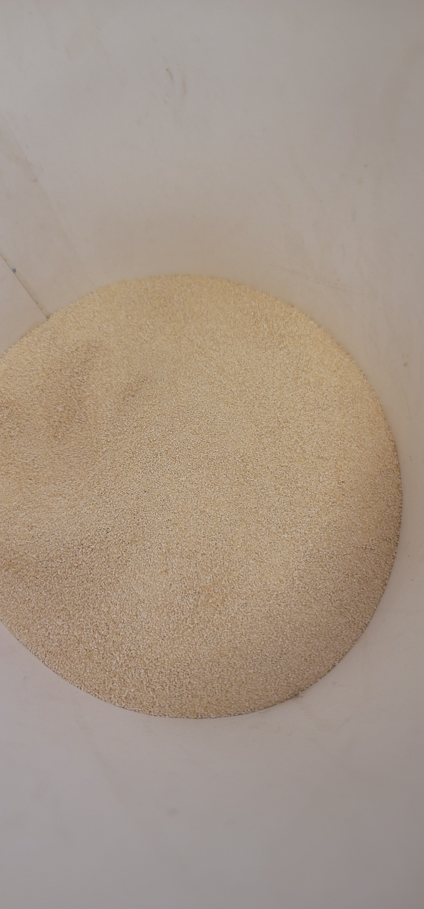
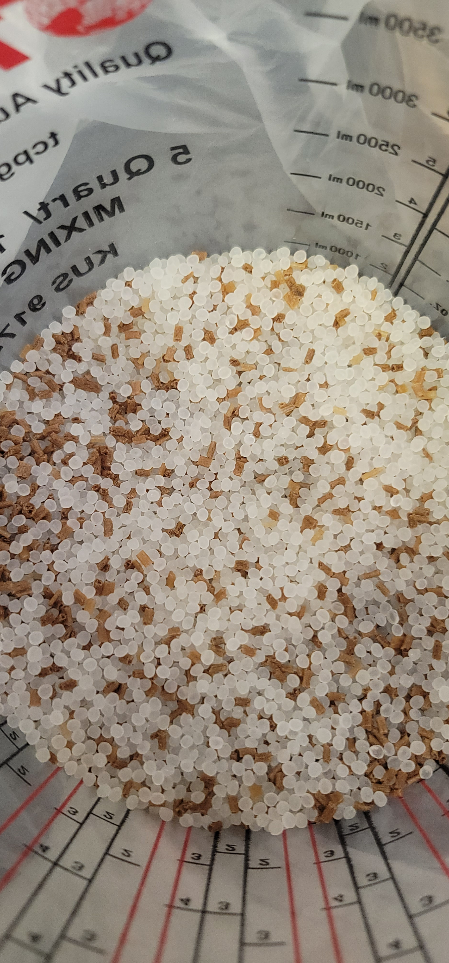
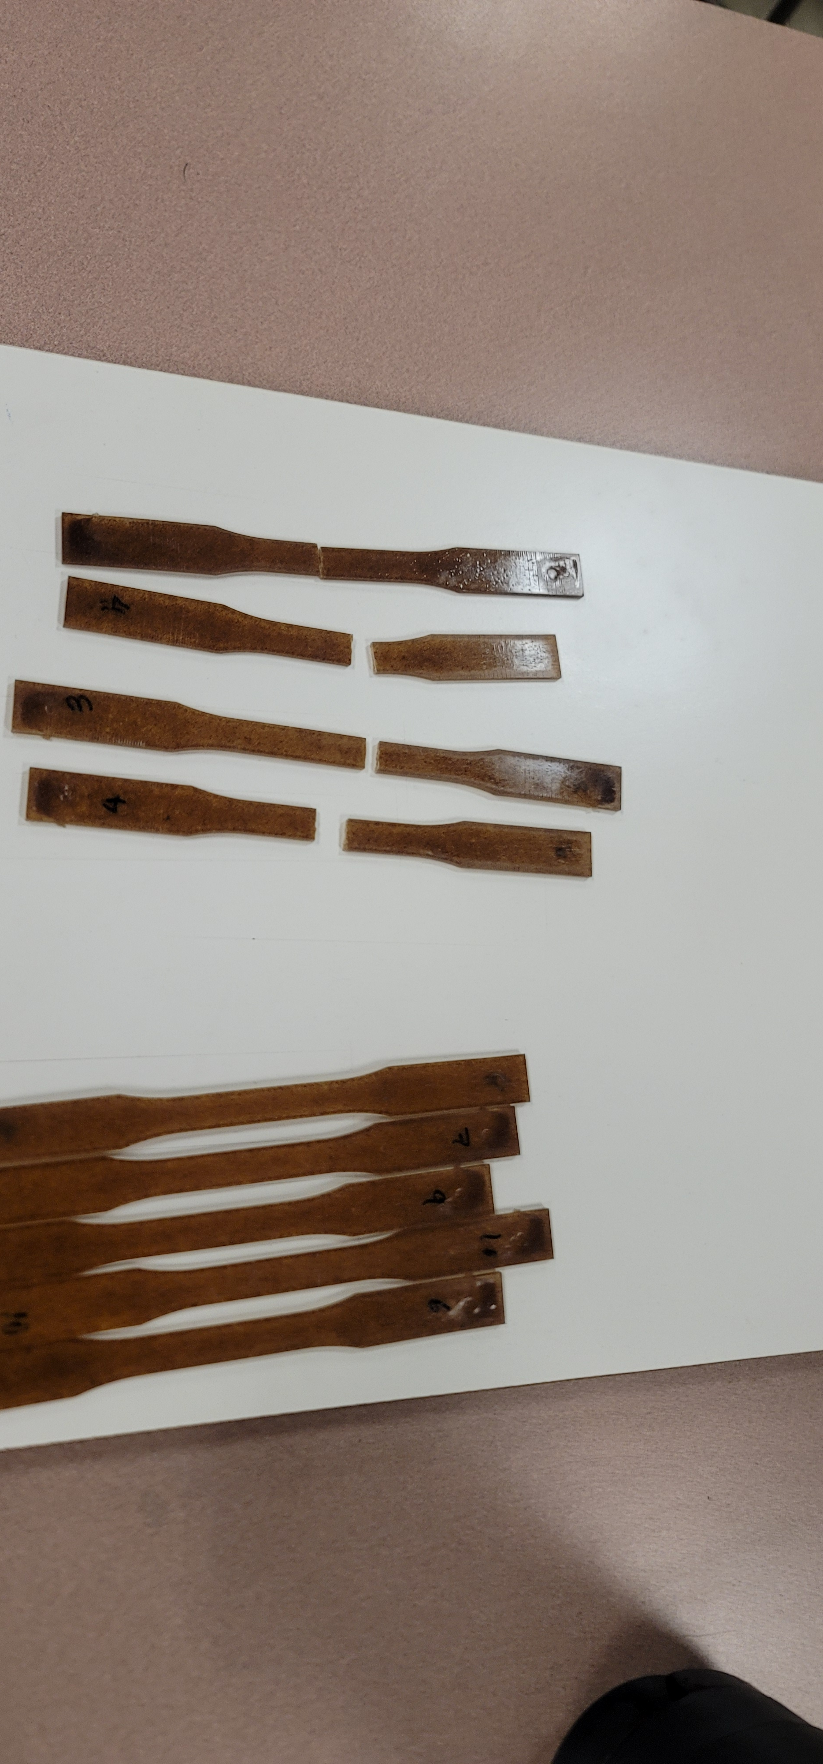
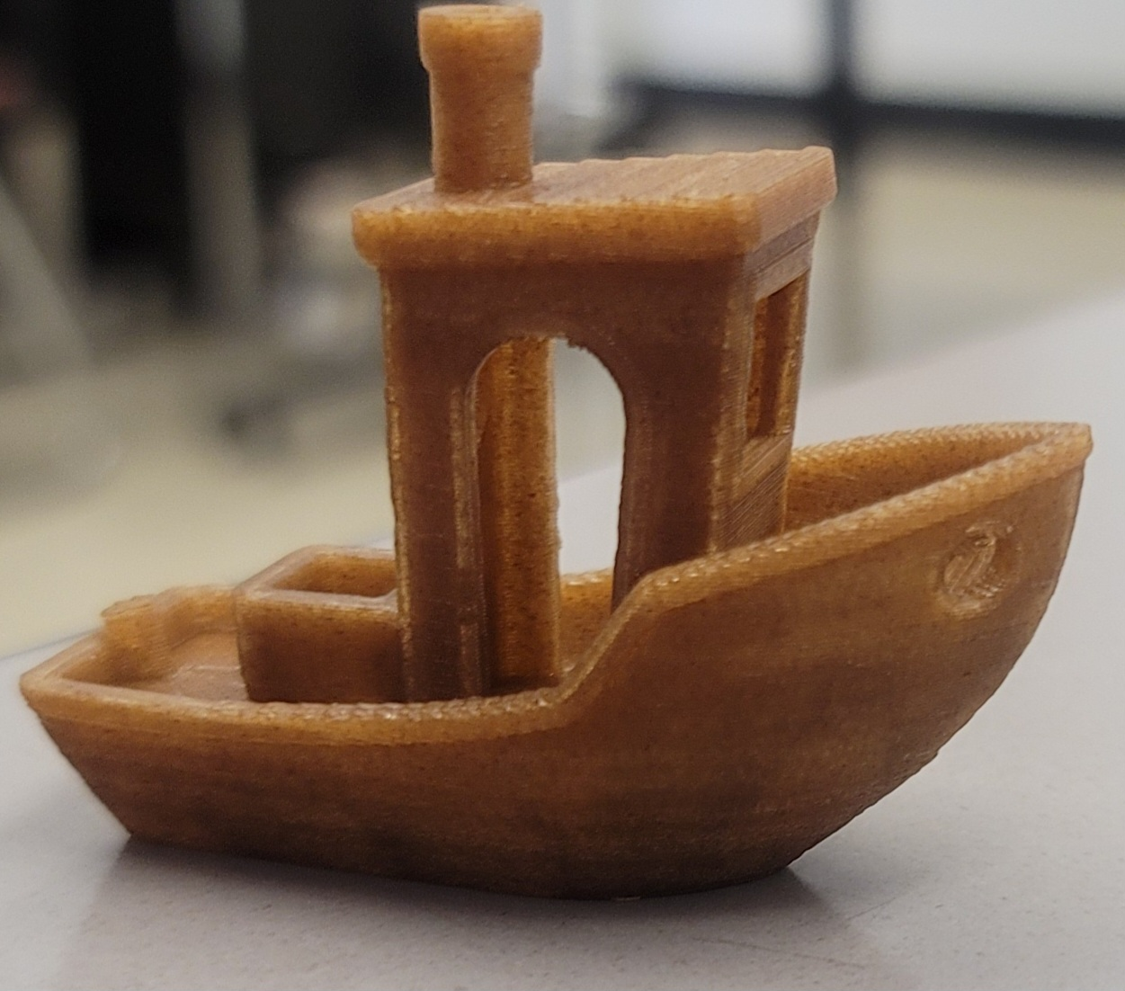
Expanding the Life of Bamboo Utensil Waste
Gonzalo Sandoval
Professor Charles J. Pooler/Advisor Dylan Sanders
Department of Mechanical Engineering, California State University, Chico
Data
Methods
In order to accomplish the task, it is necessary to grind the raw material until the granular size is obtained. Proceed to use a twin screw extruder machine to combine the powder with PLA pellets. Obtain the composite pellets that will need to be dry. Finally, create the testing samples using an Injection Molder. The testing samples will require the ASTM D638 standard for the tensile strength test, and the ASTM D256 standard for the impact test.
Introduction
Injection molding is a manufacturing process that uses heat and pressure to create three-dimensional objects from molten plastic. Bamboo has been identified as an effective filler material in injection molding, which can improve the mechanical properties; and biodegradability of the molded parts. A sustainable source of Bamboo filler material can be derived from spent utensil waste. The integration of a Bamboo filler material has been shown to:
  Increase strength: Bamboo is one of the strongest natural materials known to man. It has a tensile strength that is comparable to steel, and it is also very resistant to impact.
  Low density: Bamboo is a lightweight material, which makes it ideal for injection molding.
  Good dimensional stability: Bamboo is a very dimensionally stable material.
  Biocompatibility: Bamboo is a biocompatible material.
Objective
Compare the Mechanical Properties obtained by Bamboo-PLA, Bamboo-Polypropylene, Pure PLA, and Pure Polypropylene.
  Producing samples for both composites at 5%, 10%, 15%, and 20%
Examine the Physical Properties of the composites throughout:
  Biodegradability
  Wet-Dry Cycle
Data Interpretation
The compositive PLA-Bamboo shows a low increase in the tensile strength test (0.048kN/mm^2) in comparison with Pure PLA (0.059kN/mm^2).
Bamboo at 10% increases the impact load capacity of the compositive compared with Pure PLA. (0.78kN)
Future Work/ Suggested Research
Analyse the physical properties of the composites
Test the Mechanical Properties of PP-Bamboo and try higher percentages
Take the resting samples for the SEM test
Expand the number of samples testing
Acknowledgment
Patrick A. Newell
Sam Llyod-Harry
Jesus Cortez

